Slide 1
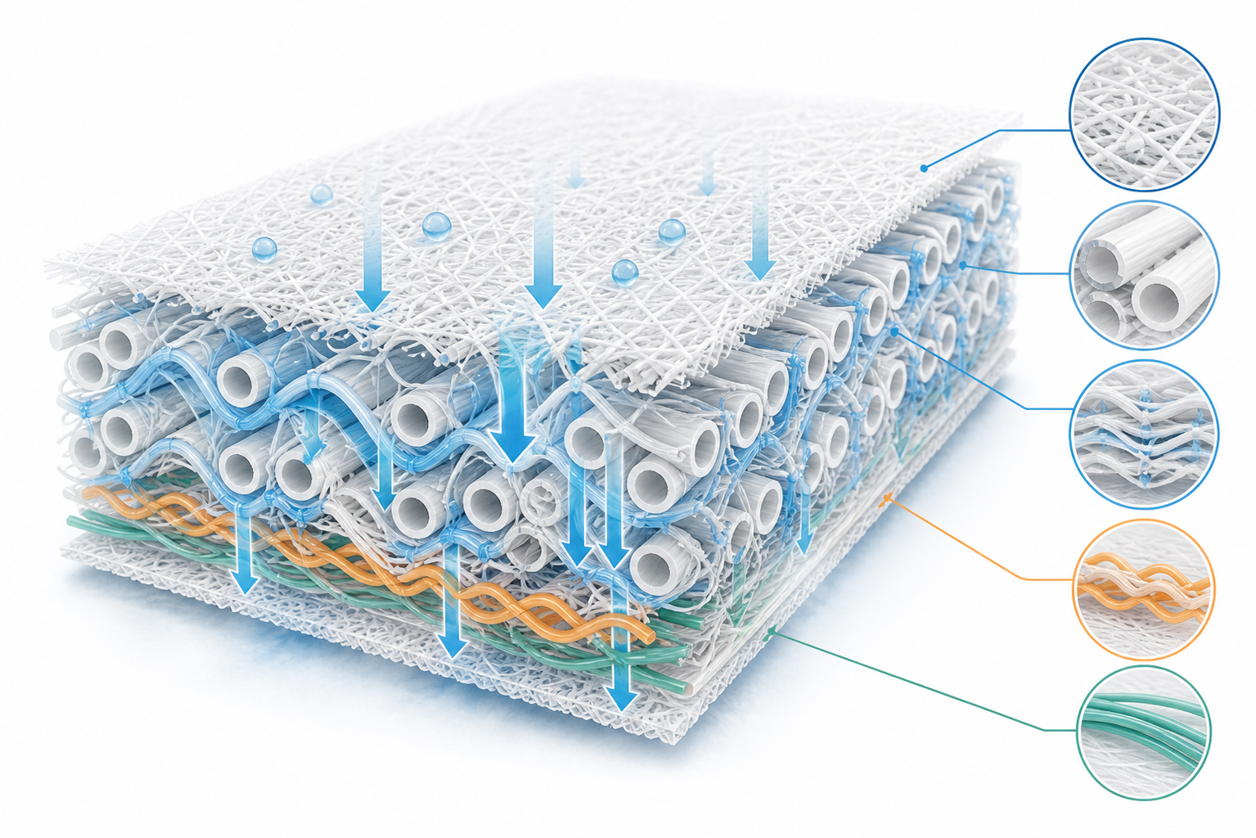


OI / IPC BCC · ONE-PAGE OI PROJECT PROFILE - 01
GATE STATUS
REL · Reinforcement / Enhancement Layer
OI Development
5-fibre reinforcement veil between two SAP layers · 33.48 gsm (Code B) · material-level SAP retention 62 % vs 23.5 % baseline · product level: net trade-off, not a proved gain
PROJECT LEAD
BUSINESS SPONSOR
MARKET
TARGET LAUNCH
CURRENT TRL
GATE
OI / FEI Team
Category BU
APAC — CN pilot
H2 2027
TRL 4 (lab → pilot)
G2 · Tianjin validation
Status & Challenge
Finished-product test · New REL vs Control
Material-level benchmark · 6 samples
Full-core assembly · GB 28004 + Cradle + L/H · n = 5 / 4 / 4 · tested 2026-09-30
Protocols differ by source · basis weight and caliper differ, so there is no single ranking
Application: in a 100% SAP fluff-less core, REL sits between two SAP layers → creates void space, prevents gel-block.
METRIC
CODE 14
CONTROL-2
Δ
READ
SAMPLE
gsm
mm
STT s
Rewet g
SAM %
1st absorption, GB (s)
24.10
25.66
−6.1 %
↑ better
Code A · new REL
28.8
1.01
1.02
0.09
62
2nd absorption, GB (s)
25.03
28.67
−12.7 %
↑ better
Code B · Minrui
33.48
0.865
1.232
0.0474
n/a
Pain points: SAP uptake insufficient · no space as SAP swells · REL clean-water wicking sub-optimal.
Rewet, GB (g)
0.500
0.492
+1.6 %
= flat
YJ DL24C
39.8
0.71
0.77
0.06
4
Leakage, GB (g)
0.650
0.466
+39.5 %
↓ worse
DY ND055
38.8
1.13
0.55
0.07
15
5 failure modes without REL: gel-block / no void / Z-collapse / poor MD distribution / rewet.
Cradle 3rd intake (s)
57.58
39.68
+45.1 %
↓ worse
ZB box REL
40.0
1.77
0.23
n/a
42
L intake (s)
9.70
7.77
+24.9 %
↓ worse
No one in the industry does this → opportunity
H intake (s)
17.93
14.68
+22.1 %
↓ worse
Qiaodong box REL
40.0
2.02
0.49
0.08
33
L rewet (g)
0.147
0.195
−24.4 %
↑ better
Baseline mean
39.65
1.41
0.51
0.07
23.5
33.48 gsm
5
62 %
L residue (g)
0.015
0.100
−85.0 %
↑ better
nominal basis weight
fibre classes in blend
SAP held ·
H residue (g)
0.010
0.055
−81.8 %
↑ better
Code A holds 62 % of SAP — 2.6× the baseline mean, but it has the highest rewet of the five measured (0.09 g) and the second-slowest strike-through.
Code B holds the best rewet (0.0474 g) at the lowest porosity, and the slowest strike-through (1.232 s). The two codes take both of the two slowest STT slots in the set.
Net trade-off. Retention (+80–85 % residue) and rewet (−24 % at L) gains are offset by leakage +39.5 % and late-insult intake +22–45 %. Material gains did not convert at product level; two variables moved at once (supplier + basis weight) and collection dates differ by 7 days.
Formulation · 5-fibre blend
Cost comparison · full cost per m² vs official 40 gsm baseline
SAM = SAP retained in the REL after the migration test (in-house method, no KC threshold). STT and rewet are material-level; the KC criteria are assembly-level, so they are directional only.
FIBRE
D × L
%
ROLE
Fibre + 5,000 RMB/t converting · 0.038 m²/pad · 100 M pads/yr · baseline 0.692 RMB/m²
2D ES CoPET/PET
2.0D × 38
32
fine capillary + primary binder
Baseline · 40 gsm, 17.3k RMB/t
0.6920
reference
3D ES CoPET/PET
3.0D × 38
8
secondary capillary + bonding
New REL · 33 gsm measured
0.6537
−5.5 %
Verdict and next gate
4D hollow ES
4.0D × 38
30
Z-channels + lumen void
New REL (Target) · 28 gsm design
0.5547
−19.8 %
REVISE
2 of 10 qualification criteria measured
7D PTT/PET S/S
7.0D × 51
24
resilience / anti gel-block
critical 34.93 gsm
6D PVA (insoluble)
6.0D × 51
6
Z-scaffold / wet strength
Basis weight, not fibre price, decides the business case. The +14.5 % per-tonne premium (19,810 vs 17,300 RMB/t) is offset by a −27 % mass saving only while actual basis weight stays below 34.93 gsm. Measured 33.48 gsm leaves a margin of only 1.45 gsm.
Acceptable but need improvement. The two criteria measured are material-level proxies, not assembly-level; the one assembly-level comparison shows a net trade-off. Cost already clears the baseline at both design and measured weight,
Code A and Code B share this composition (32 / 8 / 30 / 24 / 6); only basis weight and layer build differ.
Measured 28.97 ± 1.61 gsm (n = 30) · 2.758 mm · Code B 33.48 gsm (+19.6 %) · gradient +12.4 %
Price basis, delivered and tax incl.: PTT/PET S/S 20,500 RMB/t — Hengtan at 1,000 t scale 20,000–21,000; the 26,000 sample quote does not apply · PVA 6D 20,000 (Wanwei) · ES 2D/3D 11,600 · hollow ES 13,500 (to be confirmed) · converting 5,000 RMB/t.
Excluded: 3–5 % process loss, slitting waste, sampling amortisation, tariff and certification.
PHASE 2 · COST-DOWN PATH → COST BALANCE POINT
Open Data Gaps
Sensitivity and annualized impact
Lower basis wt
Cost balance
converge to 28 gsm
+15% → -20%
▪ Void volume @ 0.5 kPa — not measured. The 34.3 cm³/g figure is an unstressed estimate on another basis.
▪ Compression recovery (4× @ 1 kPa) — not measured on either code.
▪ Cross-web uniformity — measured defect: +3.34 gsm / +12.4 % left to right.
−19.8 %
−5.5 %
+0.0198
−3.4 M
PHASE 3 · COST-DOWN PATH → Performance Improvement
vs baseline · 28 gsm design
vs baseline · 33 gsm measured
RMB/m² per +1 gsm
RMB/yr saved · 1000 t
Crimped PVA
Lower PTT share
Cost balance
replaces straight PVA · resilience↑
24%→lower · cut costly fibre
-20%% → ？
At 100 M pads: 2.11 M RMB/yr at design weight and 2.48 M at measured weight, against 2.63 M for the 40 gsm baseline — a saving of 0.52 M and 0.15 M RMB/yr respectively. Each −1,000 RMB/t on PTT/PET (24 % of the blend) cuts a further 0.0067 RMB/m².
PATH TO
DECISION
Material benchmark · Sep 2026
›
Product 3-arm · Q4 2026
›
Scale-up lock-in · Q1 2027
›
Mass production · Q2 2027
CONFIDENTIAL · 2026-10-26
6 samples · done
supplier vs basis weight
cost balance point
TRL 6 handover

Slide 2
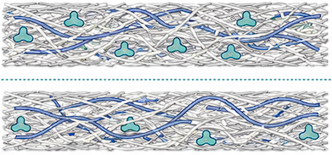
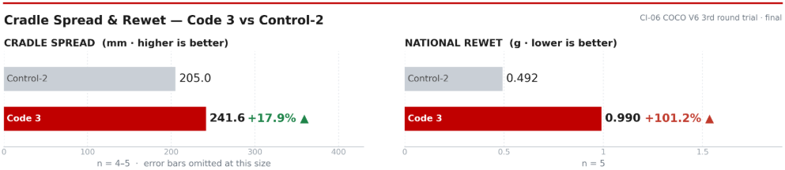
OI / IPC BCC · ONE-PAGE OI PROJECT PROFILE · 02
GATE STATUS
Baymax · Trilobal Profiled-Fibre Liner Platform
FEI stage ·
pilot validation
Trilobal cross-section fibre + in-line ultrasonic bonding: MD distribution without added basis weight | Code 1 liner · 50 gsm → core Code 3, n=5
PROJECT LEAD
BUSINESS SPONSOR
MARKET
TARGET LAUNCH
CURRENT TRL
GATE
Du Tingting · trial execution
COCO V6 platform (shared)
APAC — CN pilot
Commercial date [TBD]
FEI · pilot trial done
Off-line 600 m
Chris Wang · fibre sourcing
Product Code 3 tested (n=5)
→ 2027 on-line 500 m
STATUS & CHALLENGE
TECHNICAL CONCEPT
PRODUCT TEST · CODE 3 vs CONTROL 2
Situation: the liner is bought from Yanjan at a high unit price — no answer for cost-sensitive markets. Round fibres touch only at points, so liquid moves by pore capillarity and pools at the impact point.
Hypothesis: trilobal grooves form axial channels that align with MD after carding → liquid is drawn along the machine direction instead of stacking up.
Trial verdict: hypothesis holds on spread — Cradle spread +17.9% vs the same core with the standard liner, above the +15% design target. Price: GB rewet doubles and lateral intake slows ~33%.
Z-gradient allocation · MD groove transport
Same core, same glue (3.5×4) — the liner is the only changed variable · n=5 per leg
FIG. 1 · PLACEHOLDER
METRIC
CONTROL 2
CODE 3
DELTA
SIGNIFICANCE
MD spread — Cradle (mm)
205.0
241.6
+17.9%
✓ target +15%
MD spread — L-H (mm)
331.0
349.3
+5.5%
✓ weaker read
Z-gradient cross-section + trilobal close-up
3rd-shot intake (g)
39.68
53.36
+34.5%
✓
2nd-shot intake (g)
10.97
14.96
+36.4%
✓
FIBRE COMPOSITION & DENIER
1st-shot intake (g)
14.60
16.18
+10.8%
✓
Code 1 liner · 50 gsm · 25 gsm per layer · 102 mm wide · 4 plies
4-ply stack (A1/A2/B1/B2), groove orientation vs MD, fibre cross-section micrograph
1st intake time, GB (s)
25.66
26.51
+3.3%
n.s.
FIBRE · DENIER
gsm
%
ROLE
Rewet, GB (g)
0.492
0.990
+101%
⚠ trade-off
Top A1 · 2D Bico PE/PET
22.5
90
Skin side: softness + start of planar spread
Intake time, lateral (s)
7.77
10.36
+33.4%
⚠ trade-off
Top A2 · Trilobal 3D PET
2.5
10
Surface grooves begin; only 10% skin-side
Rewet, L-H (g)
0.20 / 0.32
0.15 / 0.32
−26% / −2%
✓ / n.s.
Bottom B1 · 4D Bico PE/PET
12.5
50
Bulk, pattern depth, compression recovery
Δ on pooled SD, n=5+5; n.s. = |t| < 2. Pad weight parity +1.3% (37.00 vs 36.51 g) confirms a like-for-like comparison.
Groove suction ≈40–50 kPa vs ≈1–2 kPa for the pore network; same-denier surface area ≈300% of round fibre — the mechanism behind the measured spread gain.
ANALYSIS · WHAT THE DATA SAYS
Bottom B2 · Trilobal 3D PET
12.5
50
Main groove network: 30% = 15 gsm of total
① Mechanism works: Cradle spread 205 → 241.6 mm (t = 15.9), clearing the +15% target; L-H +5.5% (t = 4.0) points the same way but weaker.
② Bigger win is capacity, not speed: 2nd / 3rd-shot intake +36% / +35% at equal pad weight.
③ Two costs: GB rewet 0.49 → 0.99 g (+101%) and lateral intake 7.8 → 10.4 s (+33%); 1st STT +3.3% is n.s. Rewet is the gate.
TOTAL 50 gsm · trilobal 30% (15 gsm)
peel 115.28 N measured
Incoming material (n=5): 45.22 gsm — −9.6% vs nominal 50; 1.72 mm; pH 7.11. Trilobal is 3D only, so denier cannot match the 2D layer; cut length [TBD].
READ-ACROSS
The cross-section is the transport element; the Z-gradient keeps softness out of the trade-off.
SUPPLY CHAIN · PROCUREMENT VIEW
Trilobal Fudi 3D trilobal Bico PE/PET (300 kg ready); long-term intent to switch to Home PET
Bico / trials Yanjan supplies 2D/4D Bico; Code 1 liner built in Tianjin
Cost premium vs standard liner still unquoted [TBD] — the open item for the business case
RISKS & NEXT GATE
DESIGN / PERFORMANCE
PROCESS / EQUIPMENT
SUPPLY / CONVERTING
· Rewet now the binding constraint: GB rewet +101% while spread improves — must be traded explicitly
· Higher trilobal share → interlayer bonding strength still unknown (top technical gap)
· Skin-side trilobal raises hand harshness; worse with homo-PET
· ≥142 °C rounds off the profile → trilobal "added for nothing"; trials held below 139 °C
· Pressure bonding does not work; no LSE — linear horn ≈US$70k, 500 m/min but needs floor space
· HK copy of the Herrmann module: power compatible, voltage/frequency differ → horn life at risk
· Trilobal sample volume gates the run; Fudi is a single source, Home PET substitution not qualified
· PET-containing liner acts as unbonded filler in ultrasonic seal lanes → strength drops without warning (HIGH)
PATH TO DECISION
2026 Q3
2026-10
2026 Q4
2027
TBD
Material validation
Product trial
Rewet fix
600 m off-line
Commercial
Code 1 liner tested (n=5)
Code 3 vs Control 2, n=5
close the 2× GB rewet gap
pattern clearance + 500 m
pending cost & rewet gate
CONFIDENTIAL · 2026-10-27 · IPC BCC OI / FEI
Groove moves the liquid. Rewet is the gate.

